Slide 1

Genre-Bending GANs
Blurring the Boundaries of our Favorite Musical Genres
Team:
Logan Blakely, Leila Hawana, Erik Schmauss, Eric Tsai, and Li-Yun Wang
Notes:
Two text boxes with numbers moved to the left side so they are off the slide.

Slide 2
Agenda
Introduction
Related Work
Architecture
Experiments and Results
Conclusions
Sources

Slide 3
Introduction

Slide 4
Themes
GANs are hard
Many experiments fail
Simpler is often better

Slide 5
Output
(See themes on previous slide)

Slide 6
Related Work

Slide 7
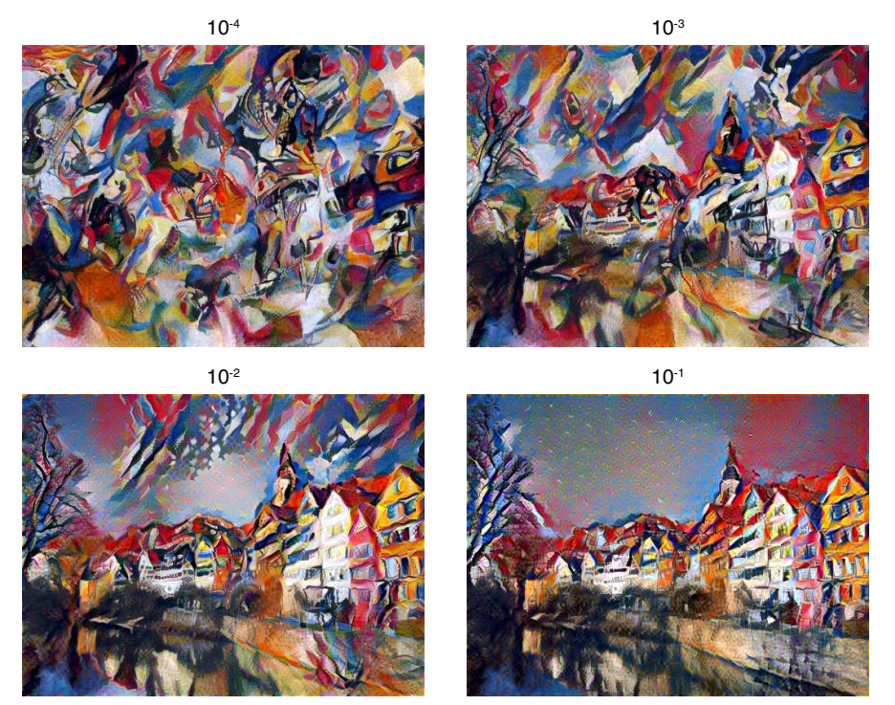
Style Transfer
We attempt this same process with music generation in one of our experiments.
Gatys et al utilized gradient descent and experimental tuning to manipulate how much style and/or content was represented in the image.
The example to the right demonstrates how the network manipulates the generated artwork.

Slide 8
Other Musical Generation Techniques
Deep Learning Techniques for Music Generation - A Survey by Briot et al provided insight into other musical generation techniques alive today.
In the paper, they explore some of what has been done in the field. Some of the basic frameworks they mention are listed to the right.
Multilayer Neural Networks
Recurrent Neural Networks
Long Short Term Memory Networks
Autoencoders
Stacked Autoencoders
Restricted Boltzmann Machines
Variational Autoencoders
Convolutional Arch Patterns
Conditioning Arch Patterns
Generative Adversarial Networks Arch Patterns
Reinforcement Learning
Various Compound Architectures (such as DeepBach, Recurrent GANs, and Hexahedria, to name a few)
This work provides significant insight as to the various directions this project could have gone.

Slide 9
Architecture

Slide 10
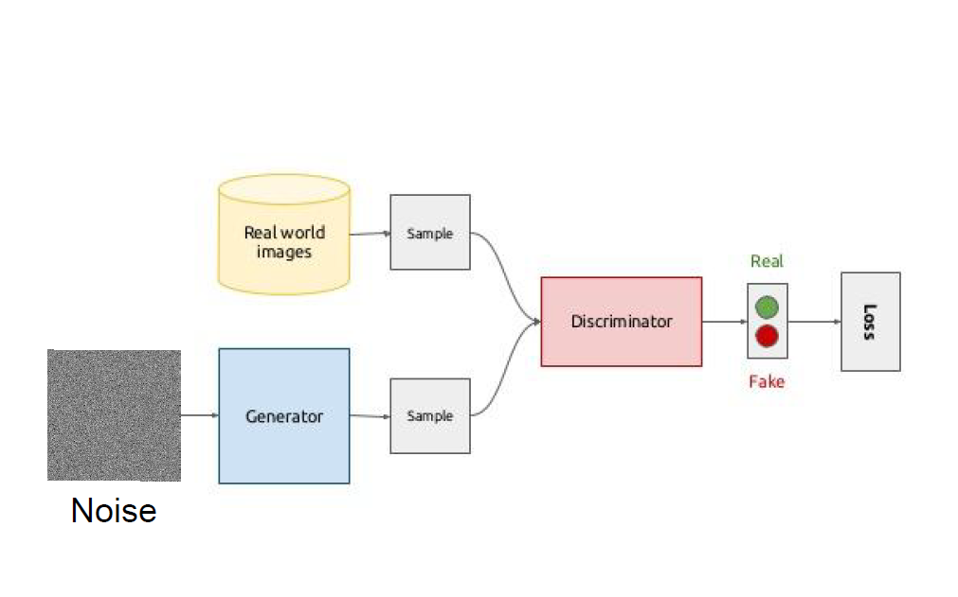
Generative Adversarial Networks (GANs)
Goodfellow et al - 2014
Unsupervised
Generate new examples of a type of data
Competing Neural Networks
Alternate training the ‘Generator’ and the ‘Discriminator’
Minimizes the KL divergence of the actual dataset and the generated dataset
Image Source: https://www.slideshare.net/Artifacia/generative-adversarial-networks-and-their-applications

Slide 11
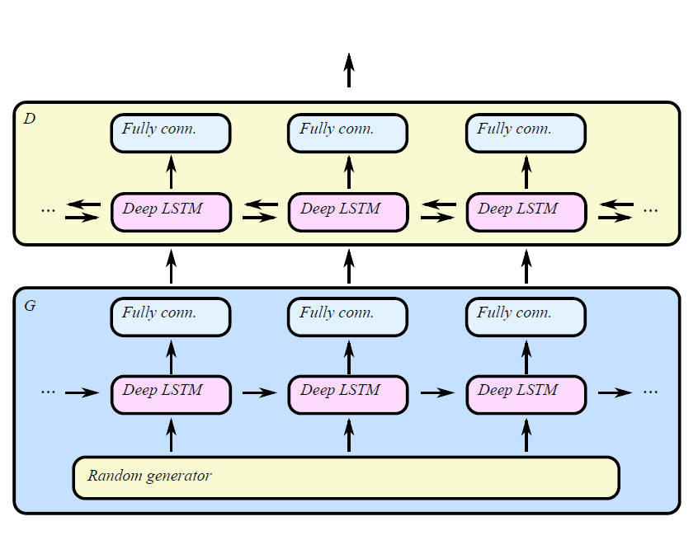
C RNN GAN: Continuous Recurrent Neural Networks with Adversarial Training (2016)
Long-Short Term Memory units (LSTM)
350 Hidden Units
Fully-Connected layer
Pretraining the generator for 6 epochs
Predicting the next event
“Freezing” the training
Pausing the training of the Generator/Discriminator to allow the other to ‘catch up’
“Feature Matching”
Loss function based on matching the Discriminator’s internal representation of real data

Slide 12
Experiments
and Results

Slide 13
Experiment 1: Normalizing the Data

Slide 14
Generalizing one composer using GAN
Each feature map contains characteristics of sound tone length, frequency, intensity, and time spent since previous tone
Two midi files generated with 200 epochs
using original data (360 samples)
using data that has been altered to limit input frequency values (250 samples)
We hypothesize that altered data set will yield better results
unaltered
transposed

Slide 15
Generalizing one composer using GAN
The difference between the two clips are not very noticable
They also do not resemble any piece that Bach wrote
For some composers, music notes have a tonal distance (intervals) with previous notes. If a tone with frequency A is played, then it should be followed by a tone with frequency B where A and B are related
Possible improvements:
Augment the data set by transposing each sample
Try different composers. They might be easier to generalize
Use more features for music generation

Slide 16
Experiment 2: Ensembling Data with GANs

Slide 17
Classical & Rock Individual
Experimentation setup
The classical music: ~ 2600 examples
The rock music: ~ 2300 examples
Fraction of validation and testing data: 10% of the total numbers
Hyperparameters: default values
Demonstration
Random sample
Original classical music
Generated classical music
Original rock music
Generated rock music

Slide 18
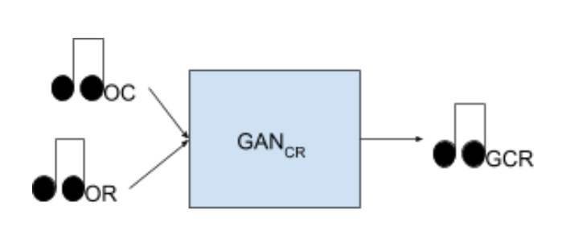
Classical and Rock Combined Original
Figure 1: This model illustrates the general GAN for this experiment. Theoretically, the model feeds in a portion of the original training data from each GAN and generates a combination of the genres.
Hypothesis: Feeding in music from both genres would generate music that sounded like both genres.
This hypothesis was proven wrong. Sample1 Sample2
Thoughts on the results:
A discriminator is trying to determine if the music is generated or not. As a mix, it would not sound like any of the input music because it is not uniquely one genre or the other.
Thus, the network had no chance of making ensembled music.

Slide 19
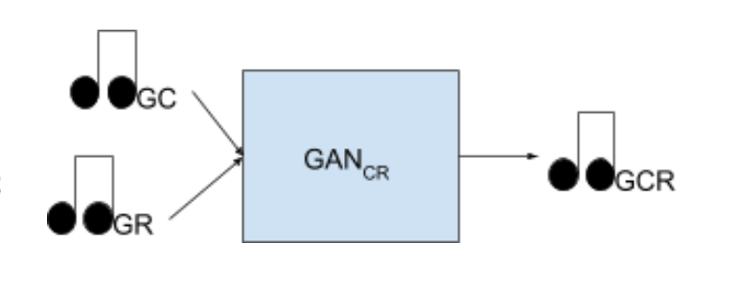
Classical and Rock Combined Generated
Figure 2: This model illustrates the general GAN for this experiment. Theoretically, the model feeds in a portion of the generated training data from each GAN and generates a combination of the genres.
Hypothesis: Feeding in generated music from both genres would generate music that sounded like both genres.
This hypothesis was proven wrong. Further, the files created were blank/corrupted.
Thoughts on the results:
Similar thoughts to previous experiment.
Corrupted/blank files could have been due to samples not being long enough.
Another potential cause: not enough training data to be sufficient.

Slide 20
Experiment 3: Linear Regression Blending

Slide 21
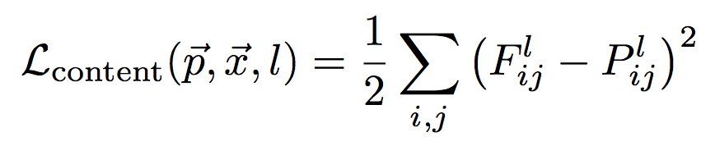

Gradient Descent

Slide 22
Linear Regression
LR
Model
Blended
Classical
Beatles

Slide 23
Linear Regression
Column | Predicted Feature | Beatles R² | Classical R²
0 | Time since last tone | 0.401 | 0.350
1 | Tone length | 0.391 | 0.528
2 | Frequency | 0.170 | 0.450
3 | Intensity | 0.221 | 0.221

Slide 24


Linear Regression
Generated Beatles
Generated Classical
Beatles to Classical
Classical to Beatles

Slide 25
Conclusions

Slide 26
Conclusion
GANs are complicated and hard to manipulate
The model integrates two complete submodels to play a two-player game for file generation
Must train two submodels simultaneously to have the generated music or image

Slide 27
Conclusion
GANs are complicated and hard to manipulate
The model integrates two complete submodels to play a two-player game for file generation
Must train two submodels simultaneously to have the generated music or image
Many experiments fail
The classical & rock generated input yielded blank or corrupt music files
The classical & rock combined original input failed to generate recognizable mixed-genre music

Slide 28
Conclusion
GANs are complicated and hard to manipulate
The model integrates two complete submodels to play a two-player game for file generation
Must train two submodels simultaneously to have the generated music or image
Many experiments fail
The classical & rock generated input yielded blank or corrupt music files
The classical & rock combined original input failed to generate recognizable mixed-genre music
Simple machine learning models achieve “sound” results
The GAN model can only work well for single genre generation
We utilized the linear regression model to generate mixed-genre music successfully

Slide 29

Questions?

Slide 30
Sources
C-RNN-GAN: Continuous recurrent neural networks with adversarial training by Olof Mogren (https://arxiv.org/abs/1611.09904)
Midi Samples (www.midiworld.com)
Source Code by Olof Mogren (https://github.com/olofmogren/c-rnn-gan)
Music Generation Architectures (https://arxiv.org/pdf/1709.01620.pdf)
Style Transfer Paper (https://www.cv-foundation.org/openaccess/content_cvpr_2016/papers/Gatys_Image_Style_Transfer_CVPR_2016_paper.pdf)
Axis of Awesome (https://youtu.be/oOlDewpCfZQ)
Google Dictionary
Information on GANs (https://en.wikipedia.org/wiki/Generative_adversarial_network)

Slide 31
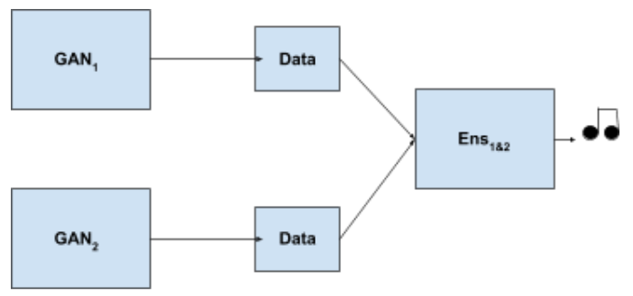
The Global Architecture

Slide 32
The Global Architecture

